Slide 1
Monte Carlo Simulation

Slide 2
Monte Carlo Simulation
Simulations where random values are used but the explicit passage of time is not modeled
Static simulation
Introduction
Simulation of the maximum value when rolling two fair die

Slide 3
Monte Carlo Simulation
IE 425 – Function optimization
Simulated annealing
Genetic algorithms
IE 415/515
Engineering economic analysis
Probability models
Integration
Project network simulation

Slide 4
Monte Carlo Simulation
Lab 1 – use Monte Carlo simulation to estimate the true confidence level of confidence intervals.

Slide 5
History
Developed by Manhattan Project scientists near the end of WWII.
Monte Carlo, Monaco has been associated with casino gambling, which is based on randomization procedures and games of chance.
Since the new simulation techniques relied on randomization procedures it was given the name “Monte Carlo” simulation.

Slide 6
Monte Carlo Simulation
Inputs to an “analysis” are unpredictable
Outputs of the analysis are

Slide 7
Monte Carlo Simulation
How do we represent unpredictability?

Slide 8
Monte Carlo Simulation
Diagram

Slide 9
Assumptions
Assume that we have methods for generating observations from different probability distributions.
How this is accomplished will be covered later.

Slide 10
Summarizing/Characterizing Risk in Engineering Economic Calculations
Much of the cash flow data used in engineering economic analysis are “best estimates”.
In reality, we do not know what the actual cash flows will be.

Slide 11
Terminology
Risk –
Uncertainty –

Slide 12
Quick Review of NPV
NPV – Net Present Value
Applicable to a series of cash flows over time.
Computes the value of all cash flows today (the present).
We will only consider years as time periods with given annual interest rates.

Slide 13
Quick Review of NPV

Slide 14
Quick Review of NPV

Slide 15
Quick Review of NPV

Slide 16
In-Class Exercise
Two alternative heating systems are being considered, gas and electric, for a temporary building to be used for 5 years. The gas system will cost $6K to install (at year 0). It is estimated that this system will have a salvage value of $500 after 5 years, and will have annual fuel and maintenance costs of $1K. The electric system will cost $8K to install and has an estimated 5 year salvage value of $1.5K. The estimated annual fuel and maintenance costs are $750 per year. The assumed MARR (interest rate) = 6%.

Slide 19
Example
Should you purchase a service contract with a new vehicle?
Your plan is to keep the vehicle for 8 years.
The service contract begins after the warranty expires (5 yrs.) and it lasts for 5 years. It covers the same items as the manufacturers warranty.
The cost is $750 at the time of purchase and it is transferable when the vehicle is sold.

Slide 20
Example
What cash flows do you need to consider?
Why only these cash flows?

Slide 21
Example
Analysis using best estimates of cash flow.
$5K
No Contract
0
1
2
3
4
5
6
7
8
$150
$700
With Contract
$5.5K
0
1
2
3
4
5
6
7
8
$750
Best estimate MARR (Interest) = 5%

Slide 22
Example

Slide 23
Example
What do we know and don’t know with certainty?
Known
Unknown

Slide 24
Addressing Risk Using Monte Carlo Simulation
Basic Approach
No approach can eliminate risk/uncertainty.

Slide 25
Addressing Risk Using Monte Carlo Simulation
Replace best estimates with probability distributions.
Generate an observation from each distribution and perform the engineering economic calculation – repeat.
The answer is now in the form of a histogram.

Slide 26
Implementation
What is required to make implementation practical?

Slide 27
MS Excel Capability
Data Tab
Data Analysis → Random Number Generation
Requires Analysis ToolPak installation

Slide 28
Simulation Demonstration
Excel
Year 6 maintenance cost
Uniform( )
Year 7 maintenance cost
Uniform( )
Salvage Value
Normal( )

Slide 29
Simulation Demonstration
Excel
Crystal Ball
Automates/expands the capabilities within Excel to conduct Monte Carlo simulations

Slide 30
In-Class Discussion
Generate ideas for making this simulation “better” (more realistic).

Slide 31
Independent Random Variables
Two random variables X and Y are independent if
Continuous random variables
Discrete random variables

Slide 32
Independent Random Variables
Properties of simple functions of independent random variables X and Y, (which are also random variables).

Slide 33
Dependent Random Variables
Properties of simple functions of dependent random variables X and Y.

Slide 34
Correlations Between Variables
Covariance Cov_{XY} is a measure of the linear dependence between two random variables
Cov_{XY} can be positive or negative.
Since Cov_{XY} is not dimensionless, it’s magnitude is relative. Correlation is “normalized” covariance.

Slide 35
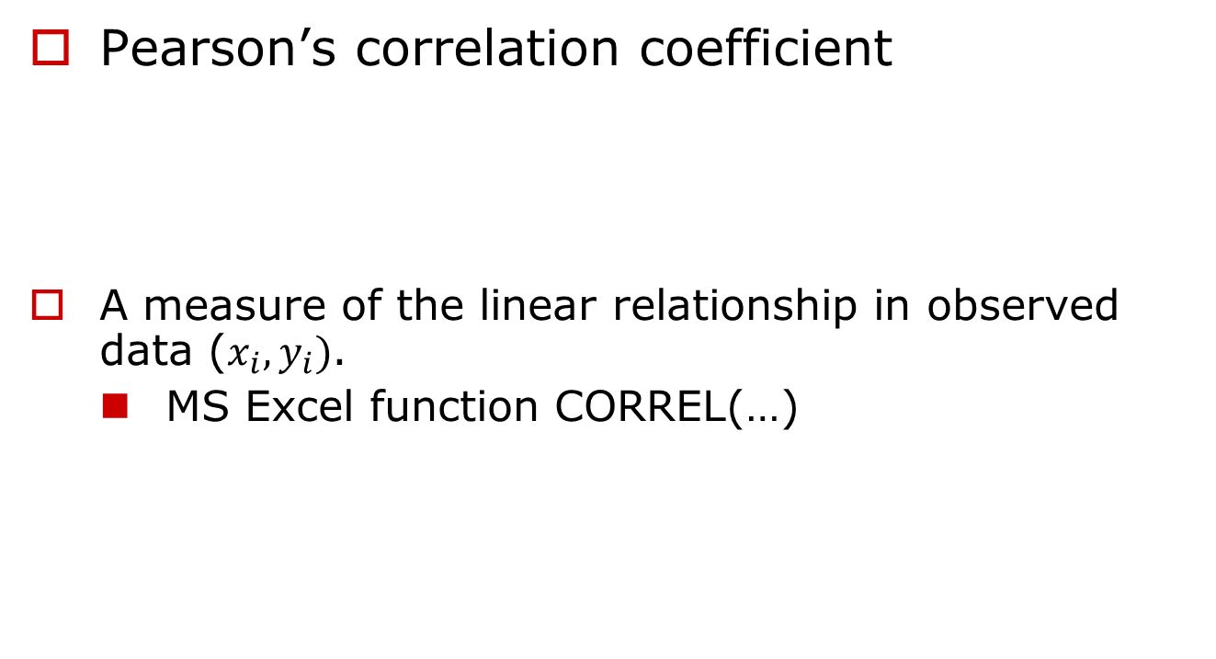
Estimates of Correlation
Pearson’s correlation coefficient
A measure of the linear relationship in observed data ($x_{i},y_{i})$.
MS Excel function CORREL(…)

Slide 36

Estimates of Correlation
Pearson’s correlation coefficient
Can determine statistical significance of the correlation if $(X_{i},Y_{i})$ has a bivariate normal distribution

Slide 37
Estimates of Correlation
Rank correlation – Spearman’s rank-order correlation coefficient.

Slide 38
Estimates of Correlation
Estimating rank correlation – Spearman’s rank-order correlation coefficient estimated from data.
Pearson’s correlation coefficient estimate applied to the ranks.

Slide 39
Estimates of Correlation
Another formula for an estimate

Slide 40
Example
Last 25 rows not shown

Slide 41
In-class Exercise
Compute Spearman’s rank-order correlation coefficient for the following paired X,Y observations.

Slide 42
Estimates of Correlation
The test of a non-zero r_{S} uses the test statistic

Slide 43
In-class Exercise
Test whether the r_{S} value computed in the last in-class exercise is significantly different from zero at alpha=0.05 (t_{8,0.025}= 2.31).

Slide 44
Extended Warranty Example
Crystal Ball simulates correlation using rank correlation.
Demo

